Slide 1
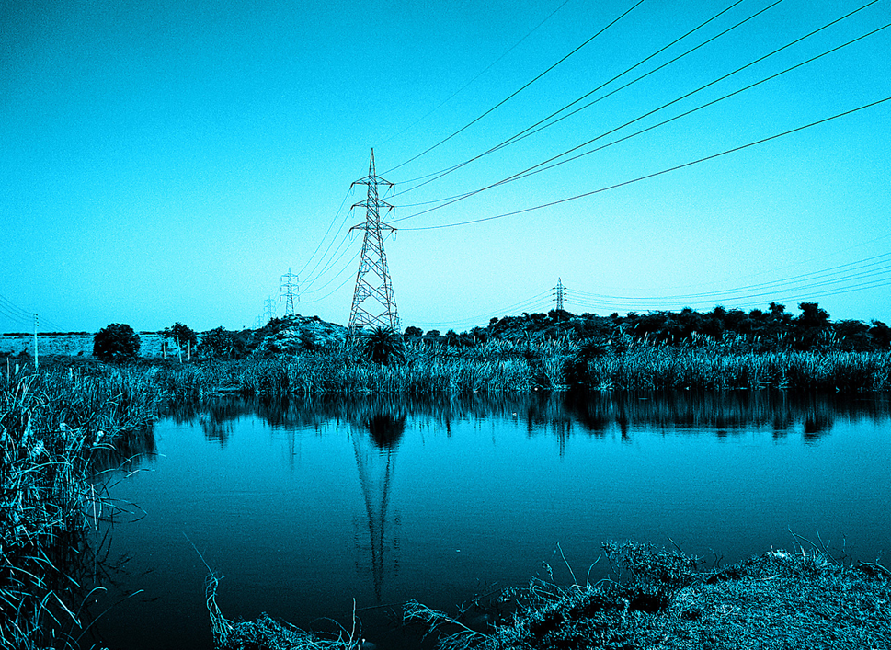

PG&E Company

Slide 2
Contents
 | Slide
Contents | 1
Introduction | 2
Analyses | 3
PESTEL | 3
Stakeholders | 4
Causes of Ethical Blunders | 6
Ethical Culture & Management | 7
Recommendations | 8
Ethical Implication Analysis | 12
Implementation Timeline | 13
Conclusion | 14

Slide 3
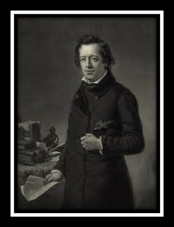
Henry Ward Beecher
“The humblest individual exerts some influence, either for good or evil, upon others.”
Notes:
Best known for his support of the abolition of slavery

Slide 4
Analysis - PESTEL
Political | Economic | Social | Technology | Environment | Legal
Influence of parties evident | Shareholders profits impacted | Safety & health consciousness | Rapid Innovation | Pollution targets | FERC/OSHA
Lobbying practices | Interest & tax rates | Ethical awareness | Conventional | Sustainability | Lawsuits prove costly
Public Entity takeover | Billing rates | Lifestyle changes | Renewable | Carbon footprints | Nuclear amendment for renewable
Notes:
P- political parties have influenced industry leaders in the past and it is likely that this will continue into the future
Lobbying practices have continued even after stopping dividend payments to shareholders in order to get second bankruptcy in 20 years
Being taken over as a public entity is a real possibility, though not a probability at this time
E- Lawsuits and fines result in less funds for shareholders and sustainability initiatives. increases in fed rate increases borrowing costs, including borrowing costs for PG&E . int rate change makes utilities investments compete with bonds
S Lifestyle changes towards more socially responsible consumers with demands, stakeholders are aware of the unethical procedures pg&E has faced in the past
T- PG&E uses hydroelectric, natural gas, coal, wind, and solar but not all of their equip up to date, the equipment is failing in comparison to comparable companies and parts of the US
hydroelectric, natural gas, coal, wind and solar generating plants.
E- environmental factor had become increasingly relevant to Influence to other factors
L- federal energy regulation comittee, occupational health and safety administration

Slide 5
Stakeholders’ Analysis
Key Stakeholders | Interest | Power | Situation
Customers & Communities | High (7) | Medium (4) | Facing power outages Health & safety risks from PG&E activities
Management | High (8) | High (7) | Dubious track record
Employees | Medium (6) | Low (3) | Pressured to meeting targets Low level morality
Investors | Low (3) | High (8) | Volatility in returns Propensity to change mindset
Government | High (8) | Medium (6) | Protects the interests of people Imposed fines (punitive measure)
1 | 2 | 3 | 4 | 5 | 6 | 7 | 8 | 9 | 10
LOW |  |  | MEDIUM |  |  | HIGH

Slide 6
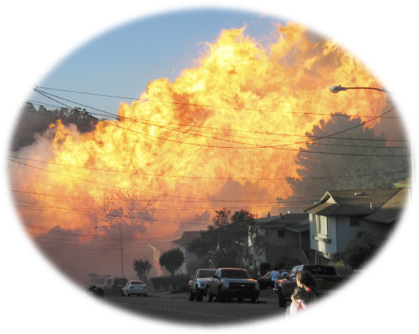
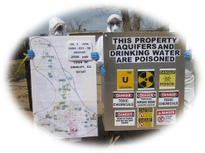
Causes of Ethical Blunders
1
5
Prioritizat-ion Error/
Denial of Responsibility
Conflict of interest
CAUSES
Lax oversight
2
Ration-alization
4
Socializing employees into corrupt practices
3
Notes:
Lax oversight by management and regulators/California Public Utilities Commission (CPUC)
(Profits and Bonuses over safety)
Providing electric and natural gas to 5m customers and jobs to 24k employees
Personal gain vs Public Safety) -OSHA

Slide 7
Ethical Culture And Management
01. Tone at the top
Committing to the ethical practices by incorporating them into the vision and mission statement
01
Tone at the top
02. Build a culture that is clear, comprehensive and consistent
03
02
ECM
Reinforce Core Values
Build a Culture
03. Reinforce core values of transparency, accountability, ownership, truthfulness, integrity, safety and reliability
Notes:
What it means to me is an environment that makes it easy to do the right thing and makes it difficult to do the wrong thing," says Michael C. Hyter, senior partner, leadership and talent consulting, at Korn Ferry in Washington, D.C.

Slide 8

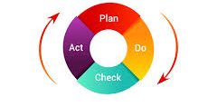
Recommendation in Action
Initiate an independent audit of existing
compliance systems
Fix the reward systems
Include compliance as an aspect for compensation
Safety and compliance initiative
Notes:
Replacing faulty high-voltages/deaths of employ lines
Meeting clean energy goals
Number of complaints asualtie
Rewards system - fixed salaries with bonuses as equity based long term incentives (stock options or restricted stocks)
Monitor executives (may lead to accounting frauds)
-Safety initiative- Plan Do Check Actees and community members reduced
Decreasing safety accidents or incidents
Number of complaints addressed ver hotline
Making reporting mandatory
Challenge - agreeing on appropriate targets in order to earn the long term

Slide 9


Recommendation in Action
Redesign training programs
Training the trainer by 3rd party professionals
Continuous training with virtual software
Dilemma analysis training
Group role play
Awareness seminars
Revise hiring process

Slide 10

Recommendation in Action
Hire a team of compliance officers/specialists headed by a Chief Ethics Officer
Appoint an independent ombudsman office and create employee awareness
Whistleblower mechanisms and complaint hotlines
Create priority customer service hotline
Employee perception survey
Customer perception survey
Notes:
Set up internal compliance task force
Replacing faulty high-voltage lines
Meeting clean energy goals
Number of complaints asualties/deaths of employees and community members reduced
Decreasing safety accidents or incidents
Number of complaints addressed ver hotline
Making reporting mandatory

Slide 11
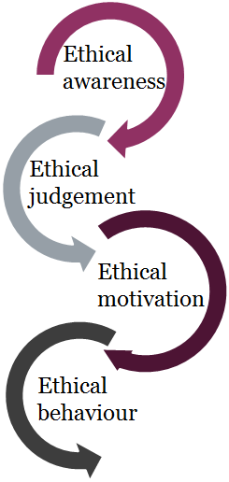
Recommendation in Action
Collective Action/CSR
United Nations Global Compact- A call to companies to align strategies and operations with universal principles on human rights, labor, environment and anti-corruption, and take actions that advance societal goals. (Sustainable Development Goals by 2030)
Repairing damages from unethical practices
Notes:
Beginning of rebuilding the PG& E brand
Collaborative action to improve water security - CWAC(California Water action collaboration) -
(e.g. settlements, community service, dedication to improvement in quality of energy provided)

Slide 12
Ethical Implication Analysis
 | Social | Legal | Employee | Financial
Fixing Reward systems
Safety Initiatives
Hiring Officers/Specialists
Independent audits
Ombudsman office
Training & Recruitment
Collective action
Repairing damages
Optimal - 3 | Feasible - 2 | Area of concern - 1

Slide 13
Timeline of Implementation
8 Month Statutory Deadline Plan (June 30th 2020)
1 | 2 | 3 | 4 | 5 | 6 | 7 | 8
Phase I |  | Phase II |  | Phase III |  | Phase IV
December | January | February | March | April | May | June | July
Fixing Rewards Systems |  | Hiring Officers/Specialists |  | Ombudsman Office |  | Collective Action
Safety & Compliance Initiatives |  | Independent Audits |  | Training & Recruitment |  | Repairing Damages

Slide 14

Conclusion
Case Examination
Ethical Implications
Pertinent & Viable Options
Ethical Leaders
Personnel
Best Wishes

Slide 15

Thank You

Slide 16
Citations
https://www.ksby.com/news/local-news/2019/06/28/state-leaders-diablo-canyon-workers-speak-out-on-power-plant-closure-impact-report
https://www.forbes.com/sites/michaelshellenberger/2019/09/03/why-california-may-go-nuclear/#249dac3aae02
https://www.shrm.org/hr-today/news/hr-magazine/pages/0414-ethical-workplace-culture.aspx
https://mariewiere.com/2012/05/31/the-pros-and-cons-of-a-hierarchy-free-lattice-organization-structure/
https://www.usna.edu/Ethics/_files/documents/Corpsman.pdf
https://www.researchgate.net/publication/320834747_Ethical_Awareness_Ethical_Judgment_and_Whistleblowing_A_Moderated_Mediation_Analysis
https://www.nestle.com/csv/what-is-csv/partnerships-alliances
https://www.unglobalcompact.org/sdgs/about

